Slide 1
Mcsim Python toolbox
How to structure it?
Mathias Marley, Feb 2022

Slide 2
Goals
Main goal: a tool that is actually used and developed
Ease of use
Ease of development
«Sufficient» documentation
Flexible and easy to modify for users

Slide 3
Main structure
Library of functions
User scripts (load model data and run simulations)
Library of model data
Model-generating scripts

Slide 4
Models
A «model» consists of
A model function, located in function library
A model parameter file, stored in .pkl files

Slide 5
Main libraries of function
MClib: general functions
MCmod: model functions
MCcon (control), MCenv (environmental), Mcsens (sensors)???

Slide 6
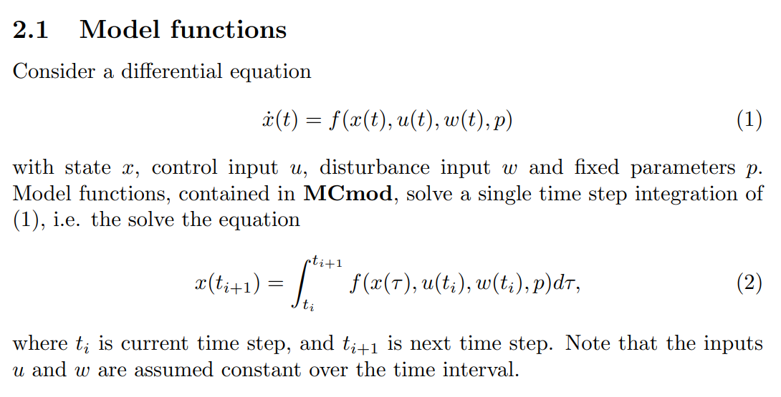
Model functions
The «core» of MCsim Python
Performs single time step integration of dynamic models
Arguments:
state, control input and disturbance input at current time step
Model parameters
Output:
state at next time step

Slide 7
Model parameters
Model parameters are given by dictionary objects
parV: vessel parameters
parA: actuator parameters
Stored to file using pickle
parV_RVG3DOF.pkl contains vessel data for RVG 3DOF model
parA_RVG.pkl contains actuator data for RVG
«Verified» model parameters are uploaded to github
Additionally example scripts to generate parV, parA etc are uploaded.

Slide 8
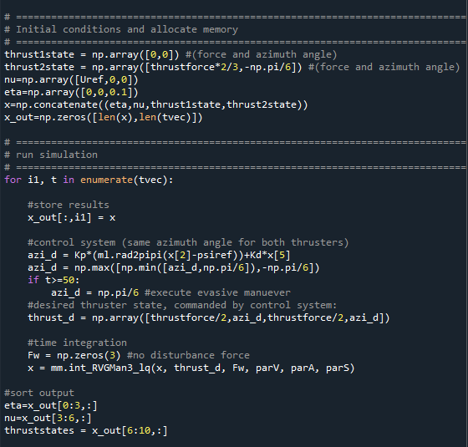
Using the toolbox
The main «user interface» is scripts that
Load model data from file
Initialize and run simulations by calling model functions in a for-loop

